Slide 1
Team Based Learning
Week 2
We form groups of 3-4 students,
Each group will discuss the question projected on the screen
After a few minutes of discussion, each group will signal with the A,B,C,D,E cards which they consider the most correct answer.
Followed by a short discussion of the reasoning.

Slide 2
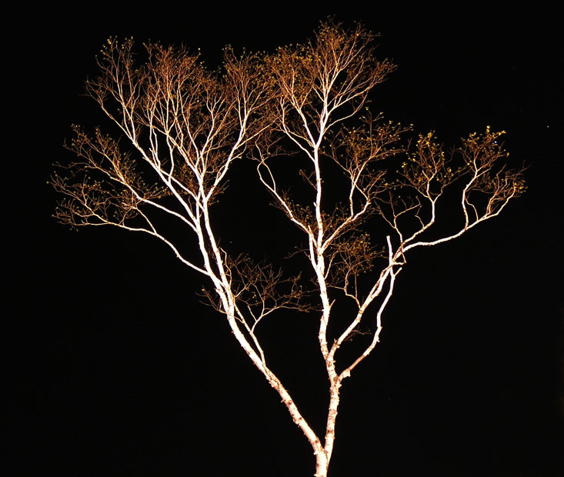
The Ribosomal “Tree of Life”
Eukaryotes
Catalytic subunits
Non catalytic subunits
Bacteria
Archaea
Archaea
Eukarya
Bacteria
Bacteria
Archaea
Eukarya
speciation
Cenancestor
(aka LUCA or MRCA)
can be placed using ancient paralogs or the echo remaining from the early expansion of the genetic code.
time
gene duplication
Notes:
ribosome not transferred between divergent organisms
using a large co-adapted cellular component is better than averaging over many different components with different histories

Slide 3
How much evolution has happened between the catalytic and non-catalytic subunits of the F1-ATPase?
Assume that the cenancestor of all cellular organisms aka LUCA lived at some time before 3.5 billion years ago:
the two subunit types are separated by at least 3.5 billion years of evolution.
the two subunit types are separated by at least 7 billion years of evolution.
This cannot be estimated, because the gene duplication had already occurred a long time before the cenancestor existed.

Slide 4
Substitution over time.
A nucleotide sequence that is not under selection experiences about 10⁻⁸ substitutions per site and year. (This is in the right ball-park for most organisms – viruses, especially RNA based have higher substitution rates).
Sequences that diverged more than a billion years ago experienced so many substitutions that they no longer show any similarity
Because of this substitution rate, the study of molecular evolution cannot reach back further than about 200 million years
To look back into the evolutionary history that occurred billions of years ago one needs to use sequences that are under strong selection against change.

Slide 5
The relationship between the three domains of life.
The relationship between the three domains of life (archaea, eukaryotes, bacteria) remains unresolved, because it is impossible to root the tree of life. The substitution rates are too different between the different branches.
The tree of life has been rooted using paralogous genes that evolved from pre-LUCA gene duplications.
Genes are frequently transferred between lineages. Consequently, each gene tree tells a different story, and the root of the organismal tree cannot be inferred from the root of individual gene trees

Slide 6
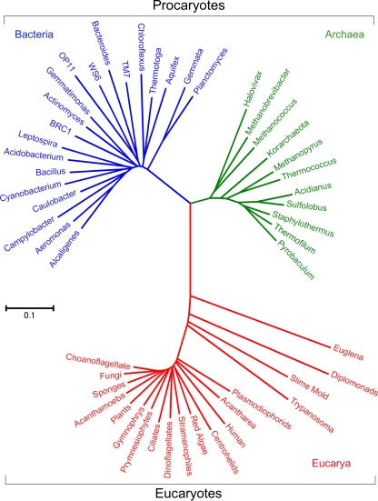
Rooting the tree of life
The tree on the right is from W B Whitman’s review “The modern concept of the procaryote” 10.1128/JB.00962-08
Based on ancient duplicated genes, where would this tree be rooted?
position 1 (on the bacterial branch)
position 2 (under the central trifurcation)
position 3 (on the eukaryotic branch)
position 4 (on the archaeal branch)
All of these are possible locations.
1
2
4
3
Notes:
position 1 (on the bacterial branch)

Slide 7
How much evolution has happened between the catalytic and non-catalytic subunits of the F1-ATPase?
Assume that the cenancestor of all cellular organisms aka LUCA lived at some time before 3.5 billion years ago:
the two subunit types are separated by at least 3.5 billion years of evolution.
the two subunit types are separated by at least 7 billion years of evolution.
This cannot be estimated, because the gene duplication had already occurred a long time before the cenancestor existed.

Slide 8

Substitution over time.
A nucleotide sequence that is not under selection experiences about 10⁻⁸ substitutions per site and year. (This is in the right ball-park for most organisms – viruses, especially RNA based have higher substitution rates).
Sequences that diverged more than a billion years ago experienced so many substitutions that they no longer show any similarity
Because of this substitution rate, the study of molecular evolution cannot reach back further than about 200 million years
To look back into the evolutionary history that occurred billions of years ago one needs to use sequences that are under strong selection against change.

Slide 9

The relationship between the three domains of life.
The relationship between the three domains of life (archaea, eukaryotes, bacteria) remains unresolved, because it is impossible to root the tree of life. The substitution rates are too different between the different branches.
The tree of life has been rooted using paralogous genes that evolved from pre-LUCA gene duplications.
Genes are frequently transferred between lineages. Consequently, each gene tree tells a different story, and the root of the organismal tree cannot be inferred from the root of individual gene trees
An argument can be made for C, although many see a consensus signal in the web ...

Slide 10

Rooting the tree of life
The tree on the right is from W B Whitman’s review “The modern concept of the procaryote” 10.1128/JB.00962-08
Based on ancient duplicated genes, where would this tree be rooted?
position 1 (on the bacterial branch)
position 2 (under the central trifurcation)
position 3 (on the eukaryotic branch)
position 4 (on the archaeal branch)
All of these are possible locations.
1
2
4
3
Notes:
position 1 (on the bacterial branch)

